Slide 1




1604C151 - DATABASE MANAGEMENT
Backup, Export, &
Import Database
WEEK 09
Informatics Engineering
Universitas Surabaya
Informatics Engineering | Universitas Surabaya
Notes:
Cover Dark
Gambar vector bisa didownload di: https://scale.flexiple.com/illustrations/
Jika ingin foto free royalty bisa download di: https://pixabay.com/photos/

Slide 2
Overview about today
The importance of database backup
How to backup and restore a database in MySQL
How to backup and restore a database in PostgreSQL
Informatics Engineering | Universitas Surabaya

Slide 3

Importance of backup database
Why backup database is important? Because It is the job of the DBA to keep the information in the company’s databases accurate, secure, and accessible.
Informatics Engineering | Universitas Surabaya

Slide 4
MySQL Database Backup
In MySQL, we can use several tools to backup and restore the database, the steps are as follows:
Use phpMyAdmin
Use Mysql workbench
Use the mysql command line

Slide 5
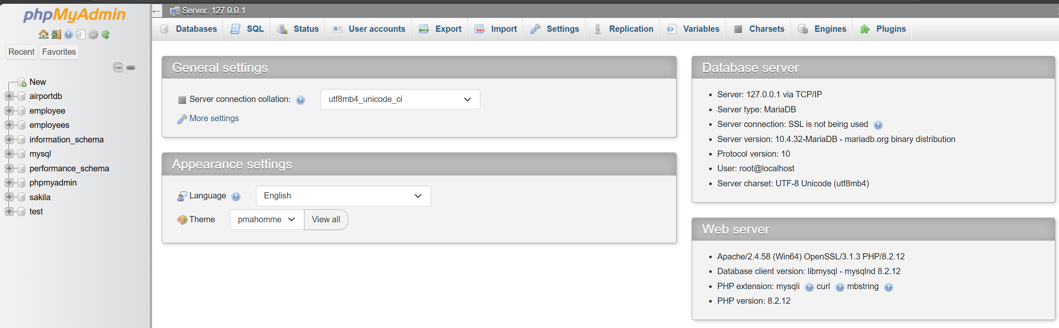
Mysql Database Backup using phpmyadmin
With phpMyAdmin, we can back up the database using the menu on phpMyAdmin.

Slide 6
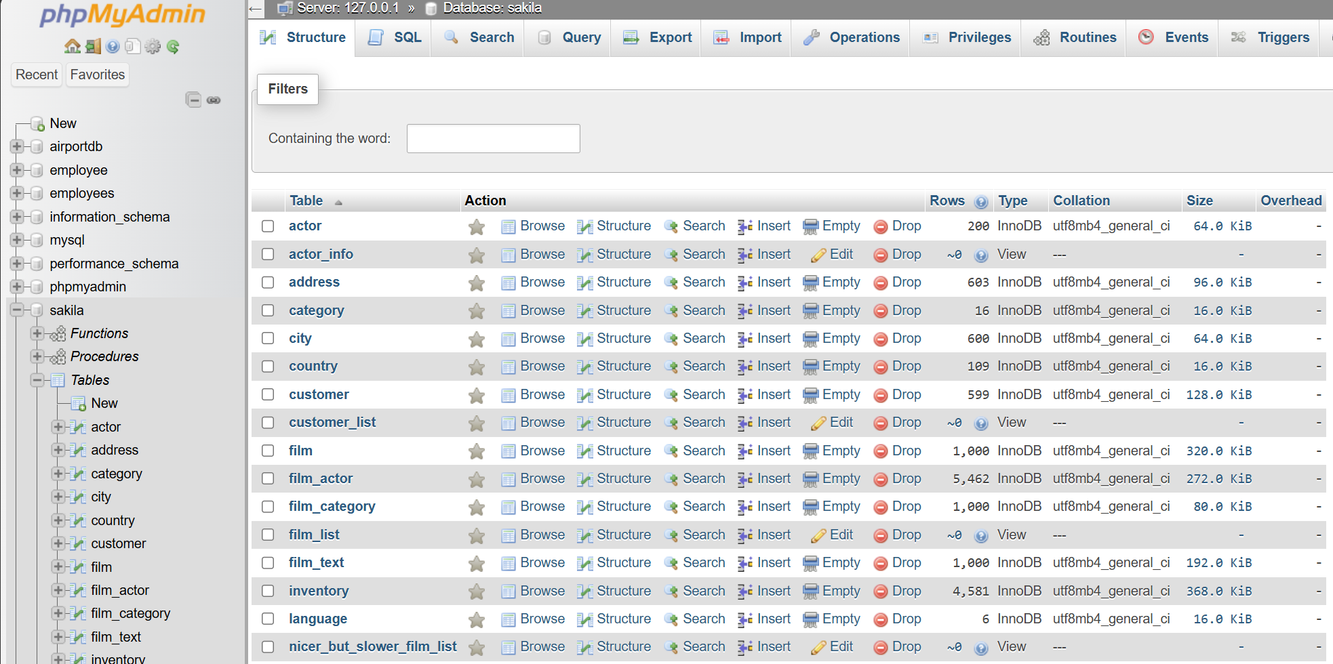
Backup database using phpmyadmin
Open your phpMyAdmin.
Choose the database that you want to be backup.
In the SQL tab above, choose export.
In this example, we use sakiladb.

Slide 7
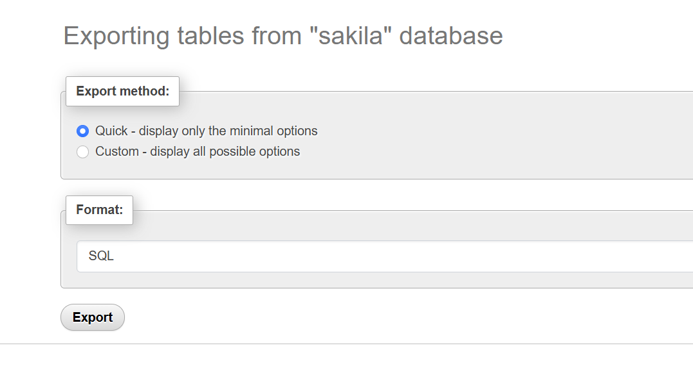
MySQL Backup Database (2)
After clicking the tab export, you will navigate to the next UI to determine what backup format you want to choose.
And also, what type of export that you want, custom or quick?

Slide 8
MySQL Backup Database (3)
After finishing, we will get the file sql that we backed up
Congratulations, you have succeeded in importing the database.

Slide 9
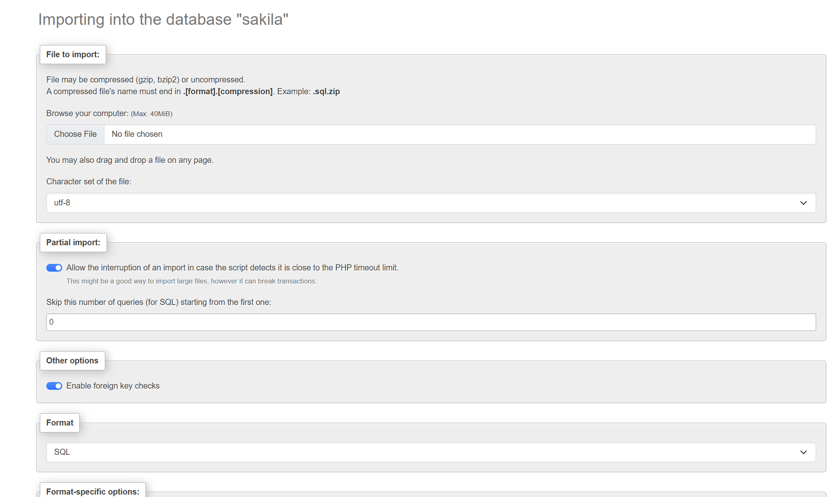
MySQL Import Database
To import the database, first, we need to create the name of the database that we want to import.
After that we choose the import menu to import the database that we want to import.
Do not forget to disable foreign key checks,

Slide 10
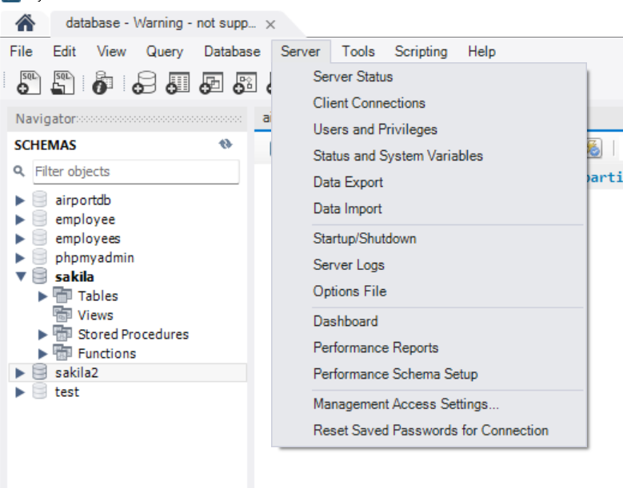
Backup Database Using MySQL Workbench
In MySQL workbench, we can export and import databases.
For the first login into the server and then go to menu server → Data export.

Slide 11
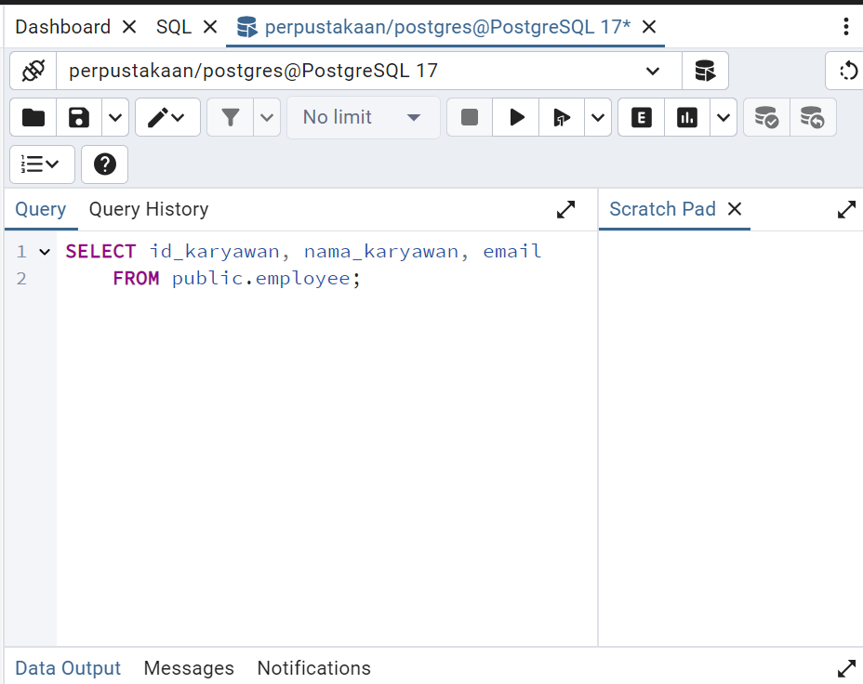
How to backup Database in PostgreSQL
In PostgreSQL, we can back up and restore the database, like in the MySQL database.
In this class, we will use the pgadmin4 to backup and restore the database.

Slide 12
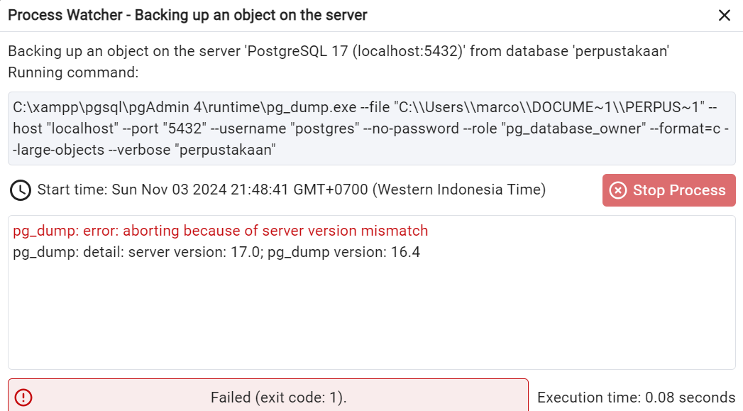
PostgreSQL Backup Notes
Important note about the backup database in PostgreSQL
Makesure the pg_dump version is similar with the pgadmin version

Slide 13
PostgreSQL Restore
To restore the database in PostgreSQL, you can go to the tools menu→ to restore
For the role, choose the Postgres role to restore the database.
Makesure the server version and the pg_dump version are the same.

Slide 14
Migration from MySQL to PostgreSQL
To migrate from mysql database into PostgreSQL Database, you can use the pg_loader library to migrate the mysql to PostgreSQL.
Or you can choose the manual way to edit the MySQL output file to change the format to PostgreSQL database.
You can choose the 3rd party application like dbeaver, and SQL Workbench/J

Slide 15
Thanks.
Informatics Engineering | Universitas Surabaya

